Slide 1
Office 365 Development

Slide 2



Recap
Introduction to Office 365 development
Module 1: Introduction to Office 365 development
Module 2: Getting started with Apps for Office
Module 3: Getting started with Apps for SharePoint
Module 4: Moving Full Trust Code to the Cloud Using Repeatable Patterns and Best Practices
Module 5: Getting started with the Office 365 APIs
dev.office.com/training

Slide 3
Deep Dive into Office 365 API for Mail

Slide 4

Agenda
Overview
Connected Services
Paging Support
Batching Support
CRUD Support
Exchange Operations using REST

Slide 5
Developer vision
USERS
DATA
HTML

Slide 6
Overview

Slide 7
Office 365 APIs for Calendar, Mail and Contacts
Office 365 APIs
Mail Message API
Contacts API
Calendar Events API
Office 365 APIs accessible through REST
https://outlook.office365.com/api/v1.0/me/messages
https://outlook.office365.com/api/v1.0/me/contacts
https://outlook.office365.com/api/v1.0/me/events
Office 365 APIs accessible through OutlookServicesClient
A library which abstracts away sending and receiving REST requests with .NET

Slide 8
Mailbox Messages
Common API operations
Reading Emails
Finding Emails
Sending Emails

Slide 9
Connected Services

Slide 10
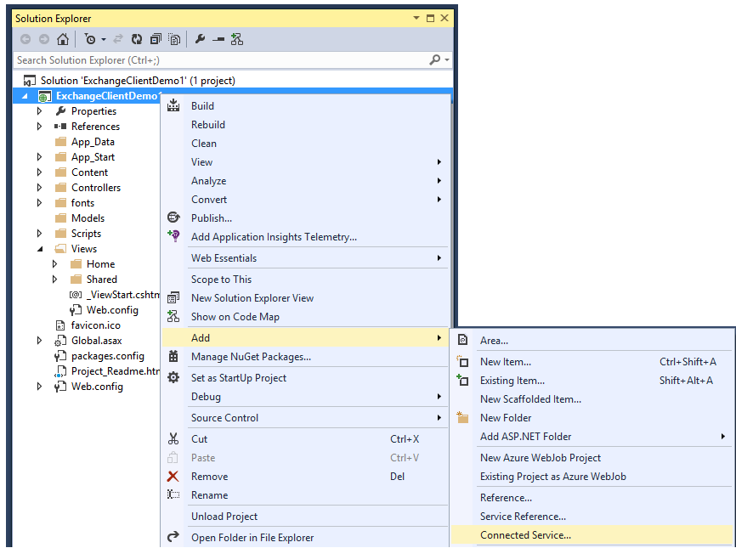
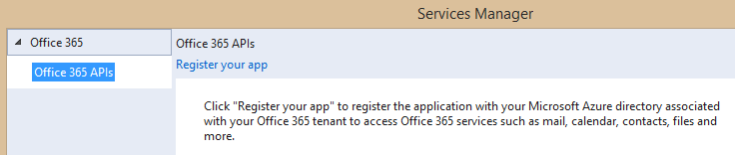
Adding Connected Services
1
Project > Add > Connected Service…
2
Register your app

Slide 11
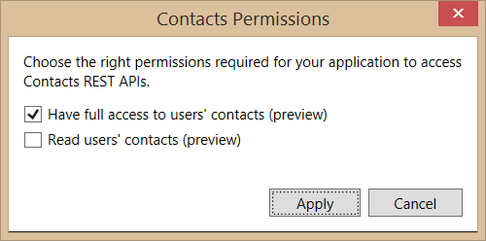
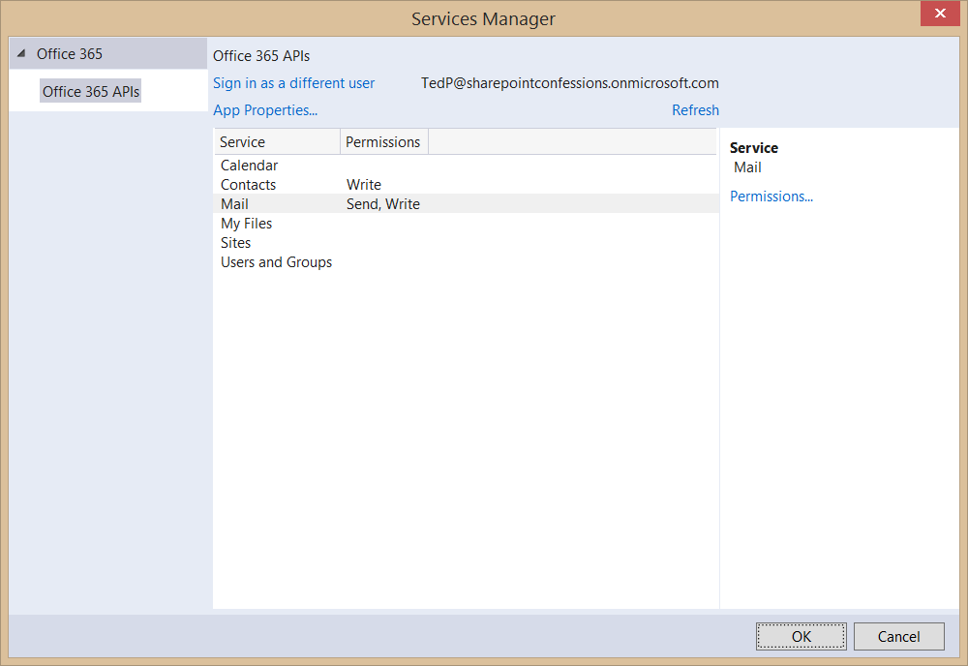
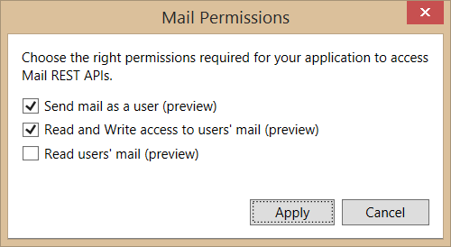
Connected Services Permissions
3
Select required app permissions

Slide 12
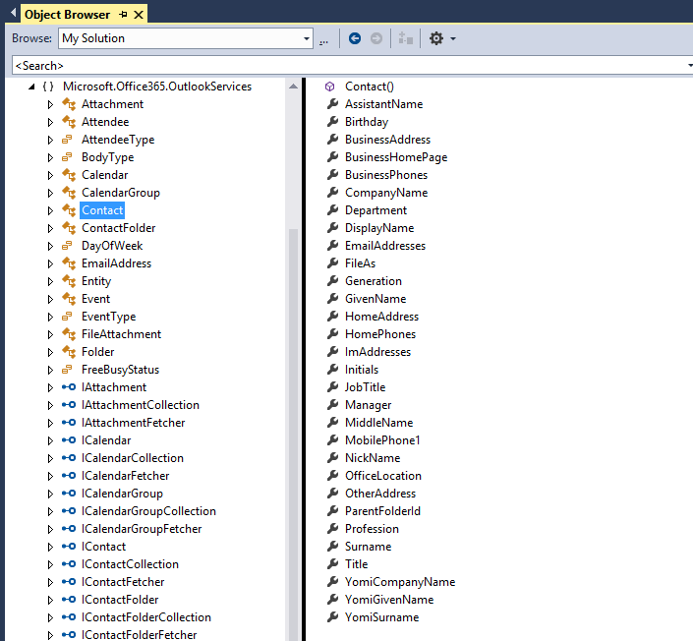
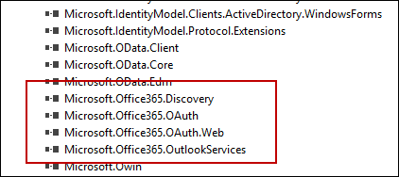
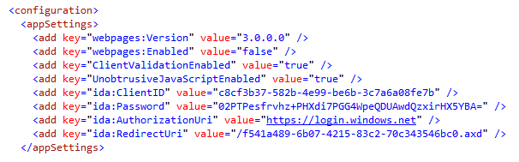
Projects with Connected Services
Assemblies added with a Connected Service
Microsoft.Office365.OAuth
Microsoft.Office365.OAuth.Web
Microsoft.Office365.Exchange
AppSettings added with a Connected Service

Slide 13
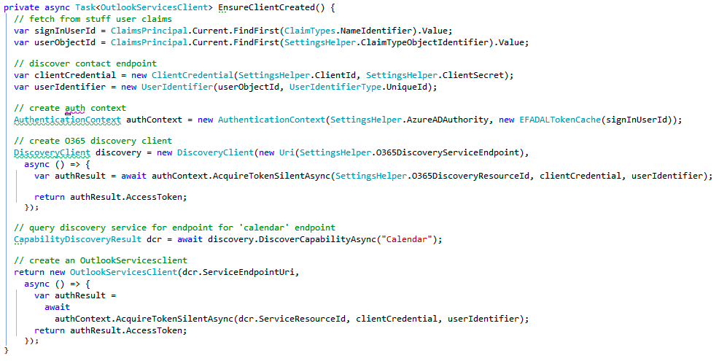
Retrieve access token using AcquireTokenSlientAsync

Slide 14
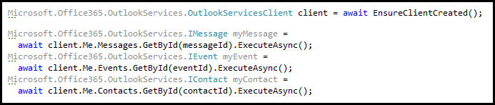
Programming with OutlookServiceClient
OutlookServiceClient provide Me property
Provides access to mail, events and contacts of currently logged in user
Explicit calls used (e.g. ExecuteAsync) to call across network to Office 365 service

Slide 15
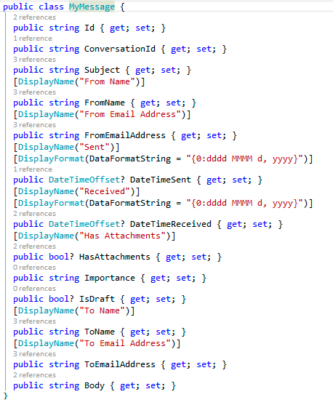
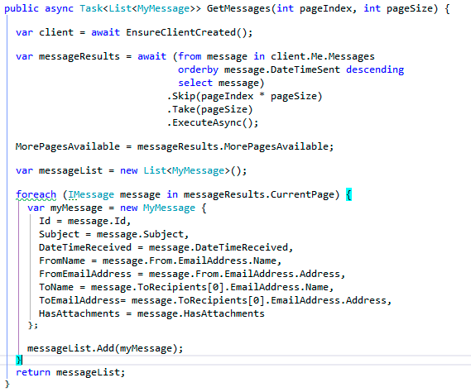
Retrieving Messages

Slide 16
demo
Creating an MVC Project that uses Connected Services

Slide 17
Paging Support

Slide 18
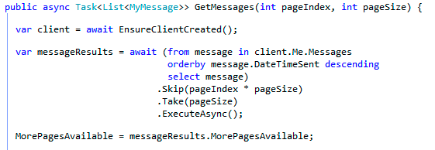
Paging with the Office 365 APIs
Limit the number of items returned by using the Take() and Skip() prior to ExecuteAsync()
Paging buttons call GetMessages which skips over the specified number of entities to present the next page
The MorePagesAvailable boolean property indicates if there are more items available

Slide 19
demo
Examining Paging Support with OutlookServicesClient

Slide 20
Batching with REST

Slide 21
REST is More Chatty than CSOM
Each action is sent as a separate request
CSOM allows for multiple requests to be sent as one
Requests are expensive & slow your app

Slide 22
Batching Support Added to O365
Office 365 REST APIs shipped with support for support with REST APIs
Batching requests with REST support added to SharePoint Online late 2014
Send multiple write & read operations in one HTTP request
SharePoint 2013 on-premises – not supported

Slide 23
Exploring the Impact

Slide 24
Overview - Batch Request
BATCH REQUEST
CHANGESET - HTTP POST
CHANGESET - HTTP PATCH
CHANGESET - HTTP DELETE
HTTP GET

Slide 25
Overview - Batch Response
BATCH RESPONSE
CHANGESET RESPONSE
CHANGESET RESPONSE
CHANGESET RESPONSE
HTTP GET RESPONSE

Slide 26
CRUD Support

Slide 27
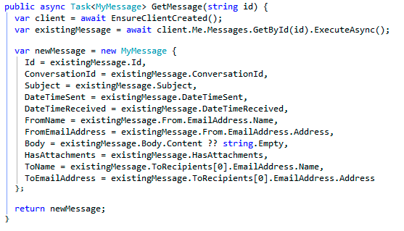
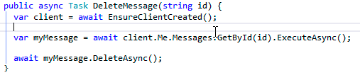
Getting and Deleting a Specific Entity
Contact retrieved by calling GetById(id)
Contact deleted by calling DeleteAsync() on Contact object

Slide 28
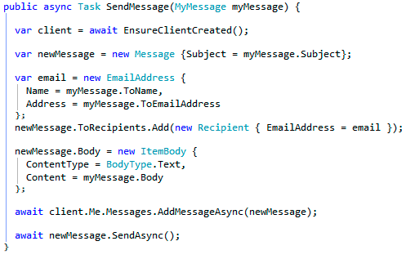
Sending Email
Call SendAsync() on Events collection

Slide 29
demo
Update operations with the OutlookServicesClient

Slide 30
Exchange Operations with REST

Slide 31
Office 365 Exchange REST APIs
https://outlook.office365.com/api/v1.0/me/rootFolder
https://outlook.office365.com/api/v1.0/me/messages
https://outlook.office365.com/api/v1.0/me/folders/<folder_id>/messages
https://outlook.office365.com/api/v1.0/me/folders/drafts
https://outlook.office365.com/api/v1.0/me/folders/sentitems
https://outlook.office365.com/api/v1.0/me/folders/deleteditems
https://outlook.office365.com/api/v1.0/me/events
https://outlook.office365.com/api/v1.0/me/events(<event_id>)
https://outlook.office365.com/api/v1.0/me/calendar
https://outlook.office365.com/api/v1.0/me/calendar/events
https://outlook.office365.com/api/v1.0/me/calendars(<calendar_id>)/events
https://outlook.office365.com/api/v1.0/me/contacts
https://outlook.office365.com/api/v1.0/me/contacts(<contact_id>)

Slide 32
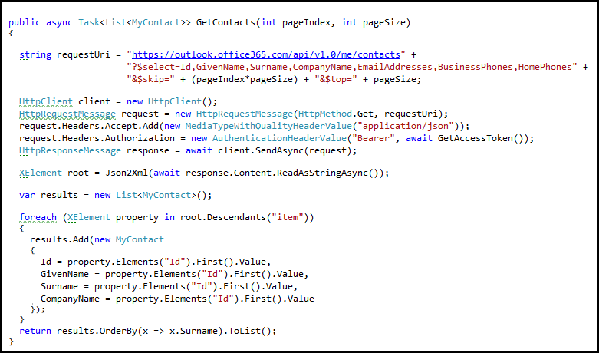
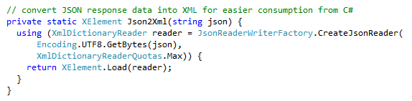
Reading Entities using REST
HTTP GET request to collection or entity endpoint
Office 365 Exchange API only returns JSON responses
Paging is accomplished using $skip and $top
Notes:
No support for $skip and $orderby so paging is post-query

Slide 33
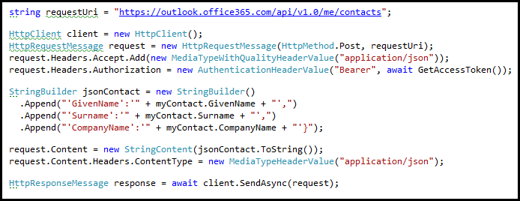
Adding a new Entity
HTTP POST to collection endpoint to add an entity
Provide minimum of @data.type property

Slide 34
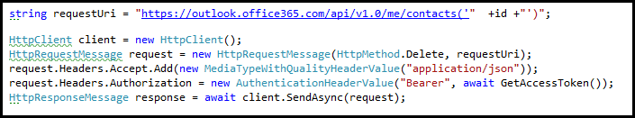
Deleting an Entity
HTTP DELETE to specific entity endpoint

Slide 35
demo
Exchange Operations using the Office 365 REST APIs

Slide 36
Summary
Overview
Connected Services
Paging Support
Batching Support
CRUD Support
Exchange Operations using REST

Slide 37
Developer Program Launch
1 YEAR FREE
E-mail Newsletters
Free Developer Subscription
Free Training
Free Tools
Webinars
http://dev.office.com/devprogram

Slide 38


Engage
Office 365 Network
https://www.yammer.com/itpronetwork
Twitter
S
S
t
t
a
a
r
r
t
t
@OfficeDev
Stack overflow
[ms-office]
Channel 9 Dev Show
http://aka.ms/O365DevShow
Podcasts http://dev.office.com/podcasts
Snack Demos
http://aka.ms/o365DevSnackDemos
UserVoice
http://officespdev.uservoice.com/

